Slide 1

SMART INDIA HACKATHON 2026
ACS - Adaptive Component Screening
Problem Statement ID – 26170
Problem Statement Title – AI-Driven Anomaly Detection in Component Burn-In & Screening
Theme – Smart Automation
PS Category – Software
Team ID – EC004
Team Name – Arch Rival

Slide 2
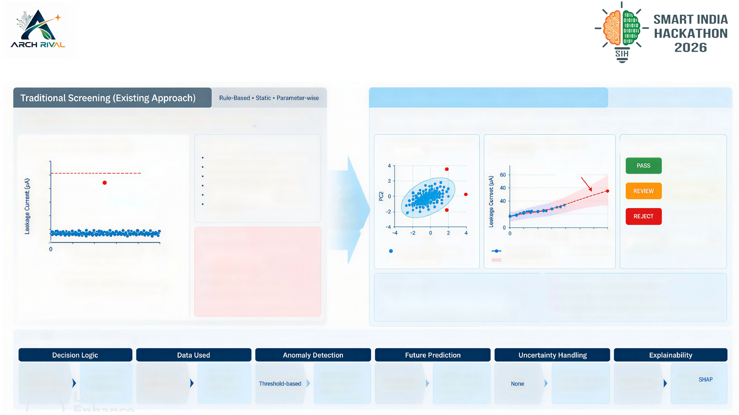
Adaptive AI Screening for Early Detection
of Latent Electronic Component Failures
ACS—Adaptive Component Screening (Our Approach)
Data-Driven + Population-Aware + Predictive
Each parameter is checked independently against a fixed datasheet limit. Components within the limit are
Learns the normal behavior from population and temporal data, detects subtle anomalies, forecasts future drift
considered PASS, even if they show abnormal trends or population-level deviations.
(168h) and provides an explainable, safety-gated engineering decision.
Parameter Check (Exampte: Iddq)
Characteristics
1. Population-Aware Detection
2. Time-Series Drift Prediction
| 3. Decision with Uncertainty
Fixed datasheet limits
(Multivariate)
(Example: Iddq)
60
Datasheet limit
Single-time measurements
Predicted to cross limit
Normal behaviour,
50
(50 pA)
No population or temporal context
(42.5 pA)
low risk
40
Passes,
Ignores subtle multivariate patterns
FROM
Bordertine / needs
but anomalous
Cannot predict future drift
LIMIT
engineering attention
30
(latent defect)
Limited handling of out-of-distribution
CHECKS
20
components
TO
20
High risk of future failure
10
LEARNING
Key Limitations
BEHAVIOUR
24
48
72
96 120 144 168
UNKNOWN
Out-of- distribution
or
Pct
Time (b)
(unknown component)
20
40
60
80
100
Misses latent defects within limits
Normal population (leamed)
Measured (burn-in)
~~~ Predicted (1686)
Components (same lot)
High false confidence
© Detected anomaly
95% Prediction Interval
Normal components
No early warning
Why It’s Better
Handles out-of-distribution components
Latent defective (still within limit)
No uncertainty estimation
Detects subtle, population-relative anomalies
Provides uncertainty with predictions
To new component families
Uses temporal trends to forecast 168h behavior
Generates human-readable explanations
Combines multiple parameters (multivariate)
Configurable safety policy aligned with mission requirements
Key Differences at a Glance
Fixed limits
Learned normal
Time-series +
Isolation Forest +
168h forecast
Prediction intervals
Parameter-wise
behavior +
Single-time
population +
Robust statistics
Not available
(Gradient Boosting)
and OOD detection
Pass/Fail only
reasons,
(per parameter)
predicted drift
measurement
multivariate
(MAD, 1GR) +
with uncertainty
(PCA distance)
contributions,
PCA-based score
(Conformal)
counterfactuais

Slide 3


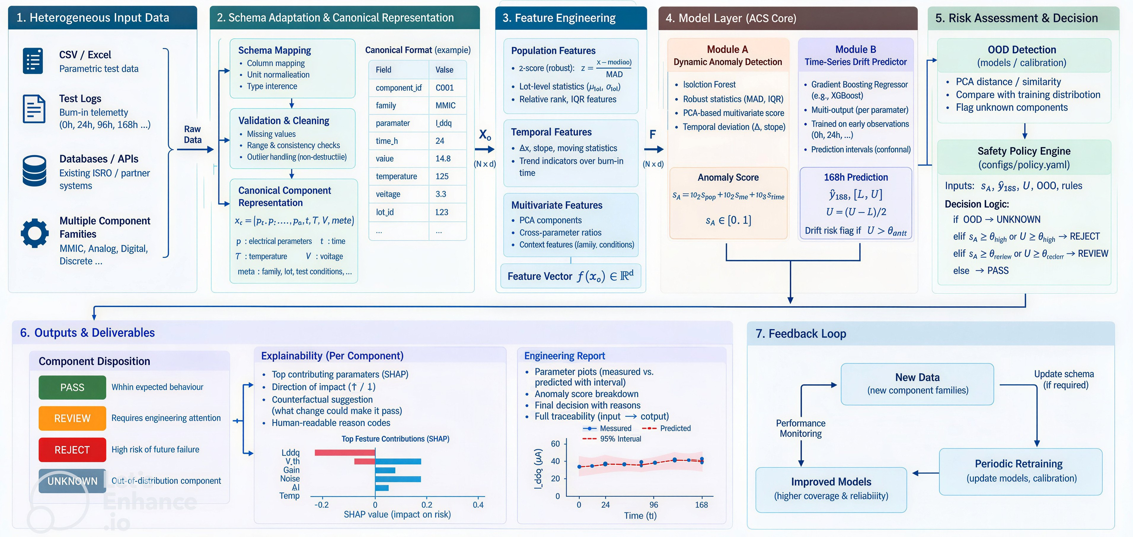
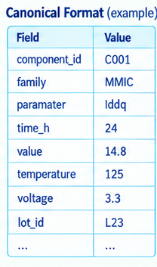








TECHNICAL APPROACH
CSV/EXCEL
Schema Mapping:
Canonical format (example)
Population Features
  • 2-score (robust) z$=\frac{x−\text{median}\left(x\right)}{1.4826⋅\text{MAD}}$
  • Lot-level statistics ($μ_{\text{lol}},σ_{\text{lol}}$)
  • Relative rank, IQR features
Parametric test data
Column mapping
Field
Value
Unit normalization
Isolation Forest
Robust statistics (MAD, IQR)
PCA-based multivariate score
Temporal deviation ($Δ$, slope)
Type inference
Isolation Forest
Robust statistics (MAD, IQR)
PCA-based multivariate score
Temporal deviation ($Δ$, slope)
Gradient Boosting Regressor
Multi-output (per parameter)
Trained on early observations (0h, 24h, ...)
Prediction intervals (conformal)
Test Logs
Burn in telemetry
0h,24h,96h,168h
Validation & Cleaning:
Temporal Features
• $Δx$, slope, moving statistics
• Trend indicators over burn-in time
Missing values
Range & consistency checks
Databases / APIs
Existing ISRO / partner systems
Canonical Format :
Multivariate Features
$$s_{A}=10⋅z_{\text{pop}}+10⋅z_{\text{time}}+10⋅s_{\text{frame}}$$
$$s_{A}∈\left[0,1\right]$$
$${\overset{ˆ}{y}}_{168},\left[L,U\right]$$
$$U−\left(U−L\right)/2$$
Drift risk flag if $U>θ_{\text{drift}}$
Multiple Component Families
$$x_{c}=\left[p_{1},p_{2},…,p_{n},t,T,V,\text{meta}\right]$$
$p$: electrical parameters | $t$: time
$T$: temperature | $V$: voltage
$\text{meta}$: family, lot, test conditions, ...
• PCA components
• Cross-parameter ratios
• Context features (family, conditions)
MMIC, Analog, Digital, Discrete
Feature Vector $f\left(x_{o}\right)∈ℝ^{d}$(or $f\left(x_{c}\right)∈ℝ^{d}$)
Top contributing parameters (SHAP)
Direction of impact (↑ / ↓)
Counterfactual suggestion (what change could make it pass)
Human-readable reason codes
Parameter plots (measured vs. predicted with interval)
Anomaly score breakdown
Final decision with reasons
Full traceability (input → cutup)
Measured
Predicted
With in expected behavior
Requires engineering attention
High risk of future failure
Out-of-distribution component

Slide 4

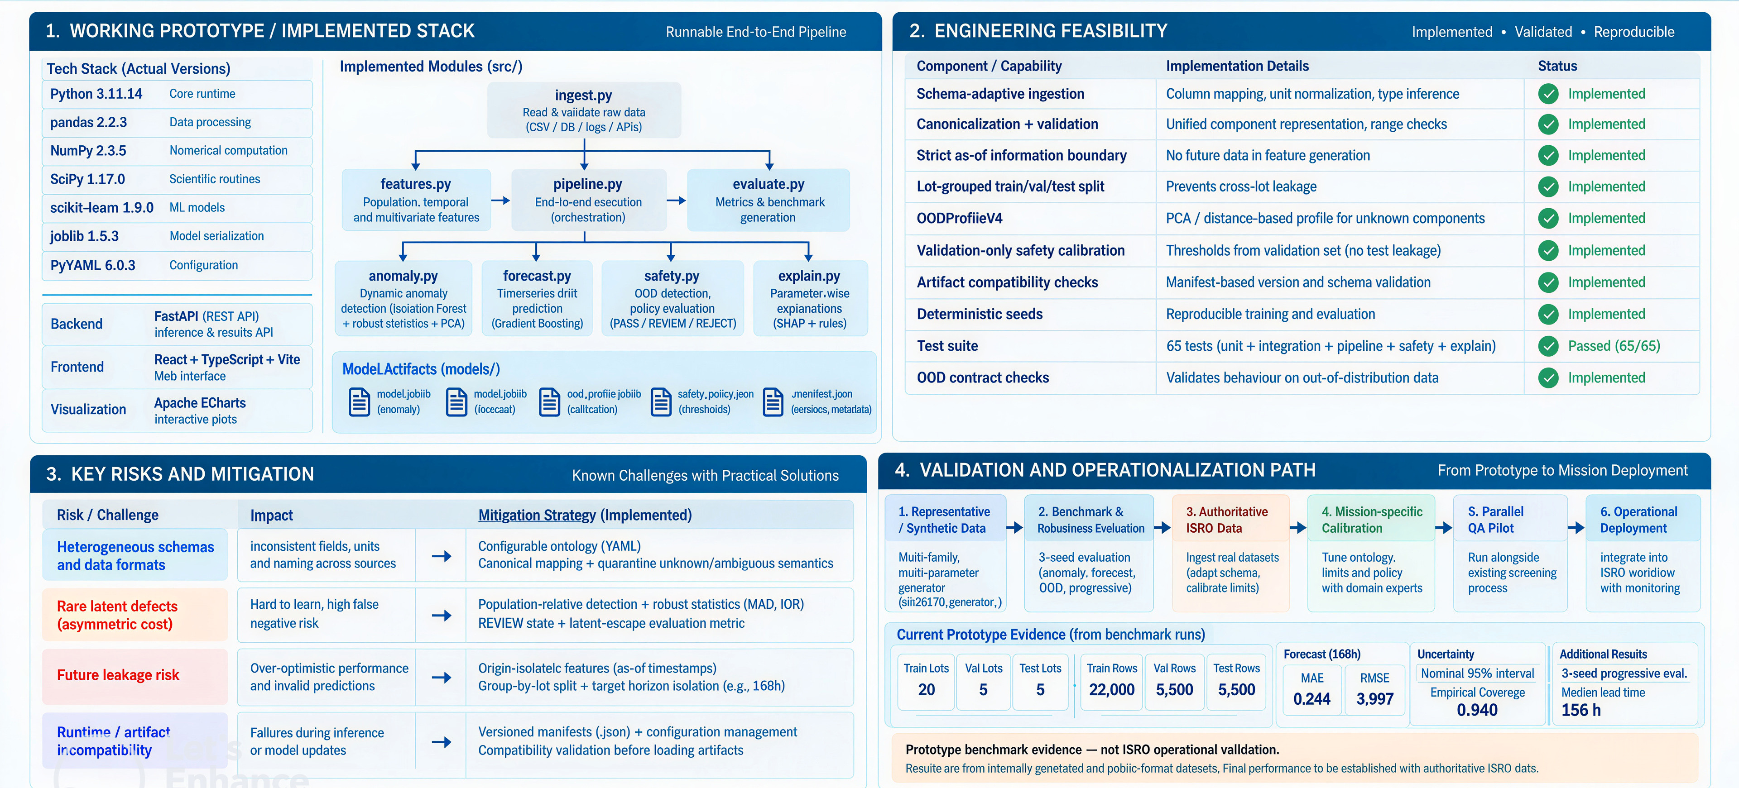
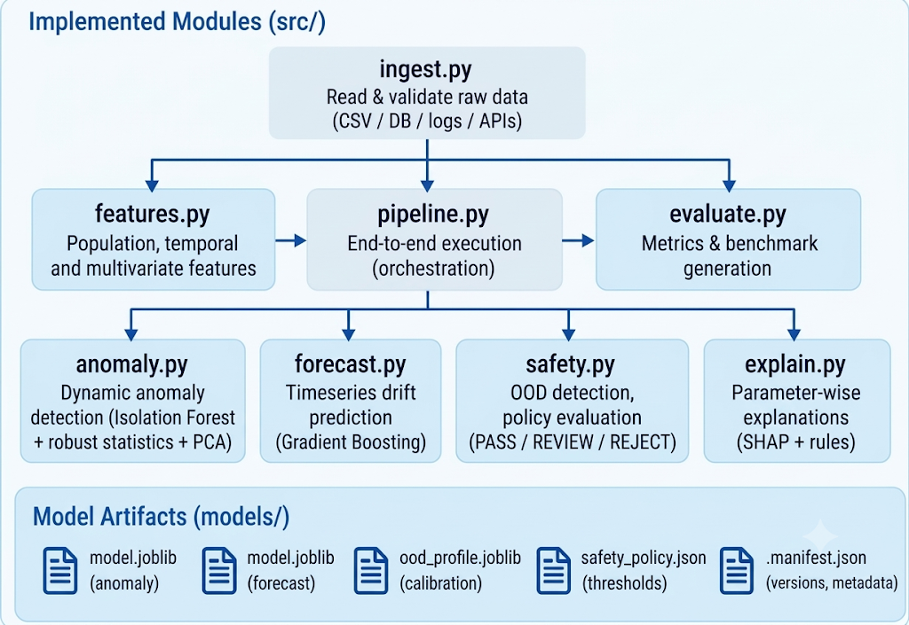
FEASIBILITY AND VIABILITY
Analysis of the feasibility of the idea
Potential challenges and risks
Strategies for overcoming these challenges

Slide 5
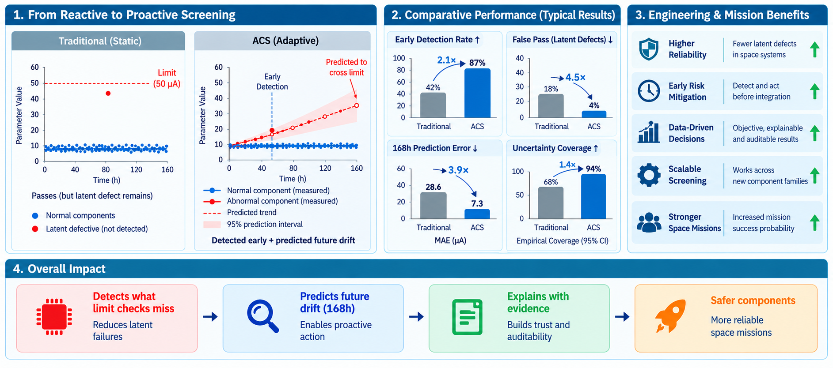
IMPACT AND BENEFITS

Slide 6
RESEARCH AND REFERENCES
Domain / Space Reliability
Machine Learning and Statistics
[1] SIH 2026 — PS 26170
Problem definition, latent defects, 168 h prediction, explainability
https://www.sih.gov.in/sih2026PS
[2] NASA EEE-INST-002
EEE selection, screening, qualification and derating.
https://nepp.nasa.gov/pages/EEE-INST-002.cfm
[3] NASA PT-TE-1401
EEE screening, early-life failures and parameter drift.
https://extapps.ksc.nasa.gov/Reliability/Documents/Preferred_Practices/1401.pdf
[4] ISRO Public QA/Procurement Requirement
EEE inspection, data-package verification and traceability context.
https://eproc.isro.gov.in/home.html
[5] NASA Flight Electronics Environmental Stress Screening Survey
Environmental stress screening and latent-failure context
https://ntrs.nasa.gov/citations/19840013934
[6] Liu et al., 2008 — Isolation Forest
Multivariate anomaly detection.
https://cs.nju.edu.cn/zhouzh/zhouzh.files/publication/icdm08b.pdf
[7] Robust covariance / robust statistics — scikit-learn
Robust population statistics under contamination.
https://scikithttps://scikit-learn.org/stable/auto_examples/covariance/plot_robust_vs_empirical_covariance.html
[8] Shafer & Vovk, 2008 — Conformal Prediction
Prediction intervals / uncertainty.
https://jmlr.org/papers/v9/shafer08a.html
Explainability
[9] Lundberg & Lee, 2017 — SHAP
Feature attribution for interpretable ML.
https://papers.neurips.cc/paper/2017/file/8a20a8621978632d76c43dfd28b67767-Paper.pdf
Complete Project Documentation - https://drive.google.com/file/d/189mMLKakpU7hSJQMZQVkKwX74vK1W4xH/view?usp=sharing
Complete Project Repository - https://github.com/RazeenaTasneem/ACS---Demo
References informed the engineering design; mission-specific limits and acceptance criteria remain to be calibrated against authoritative operational data.

